Slide 1
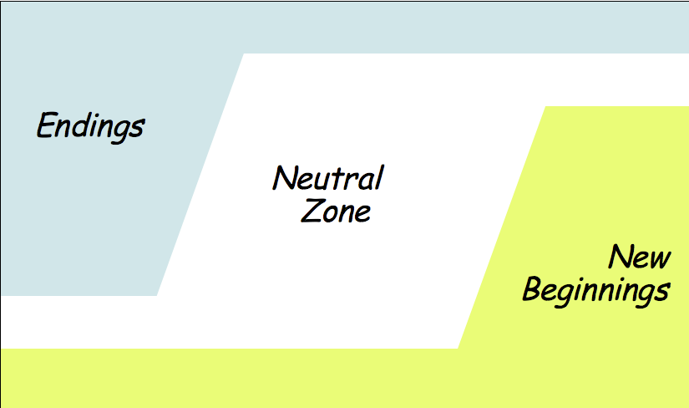



Boston’s Transition from Legal Segregation in Education
BROWN
V
BOARD
OF
EDUCATION
“Busing”
= struggle for Race and class equity, democratic access and excellent quality for all
Adapted by Union of Minority Neighborhoods from Managing Transitions: Making the Most of Change, by William Bridges, 1991

