Slide 1
Let’s Talk:
Latinos and the desegregation of the Boston Public Schools
Miren Uriarte, PhD
University of Massachusetts Boston
miren.uriarte@umb.edu
This presentation is part of a larger work entitled “What Makes Change? Bilingual Education in the Boston Public Schools, 1971-2010”.

Slide 2
Latinos in Boston
 | 1960 | 1970 | 1980
Total Latino Population | 1,858 | 16,637 | 36,430
Puerto Rican | 51.40% | 44.03% | 51.88%
Cuban |  | 17.26% | 8.08%
Other nationalities | 48.6% | 38.71% | 30.04%

Slide 3
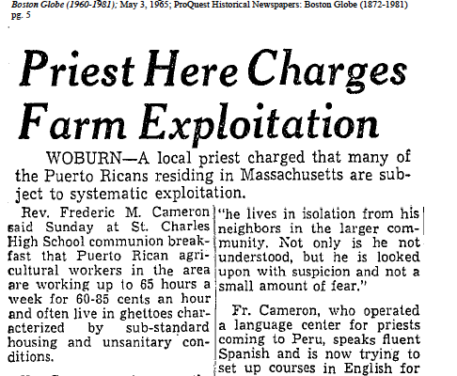
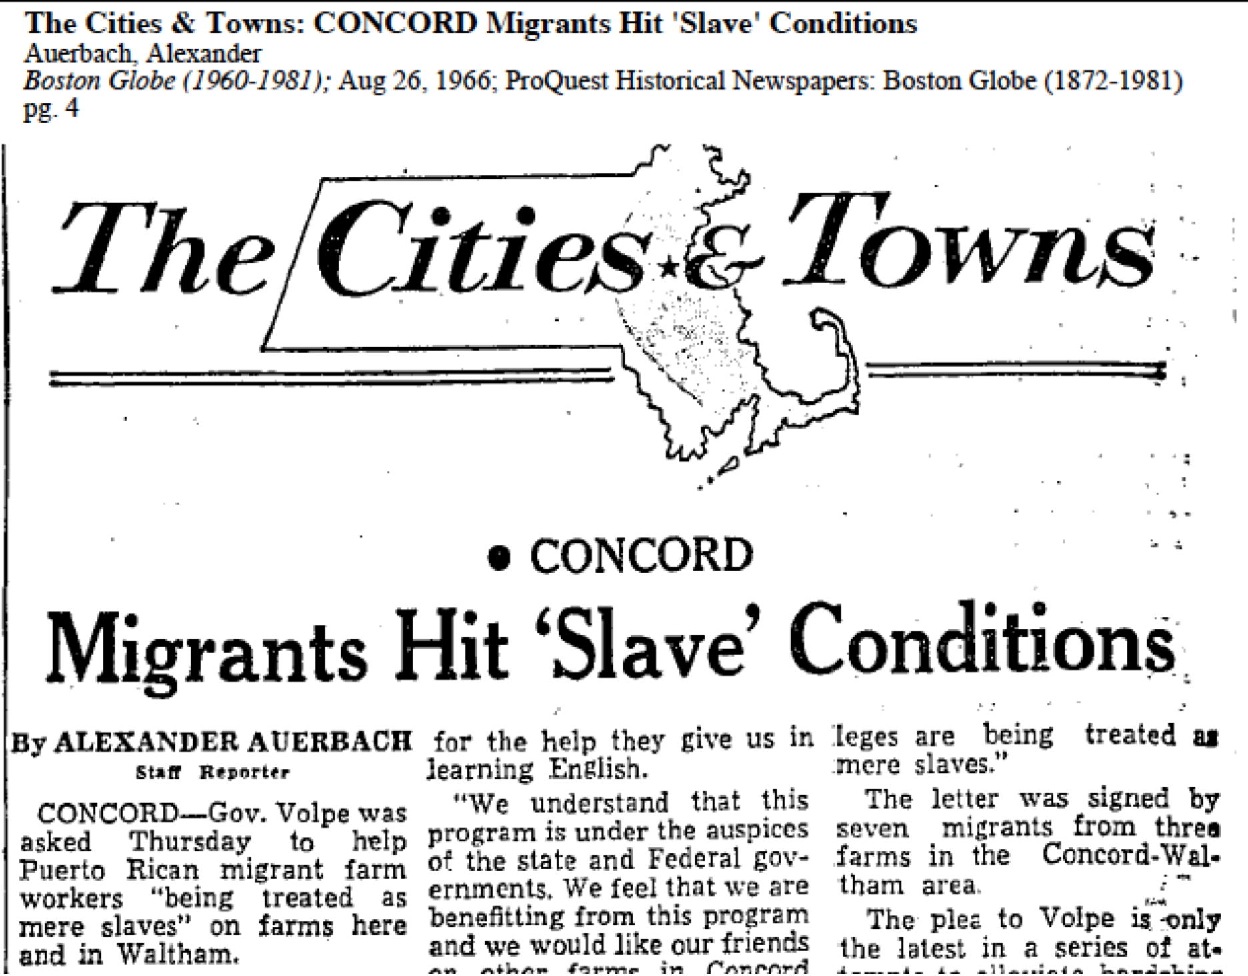
Conditions
….of Migrants in the Farms

Slide 4
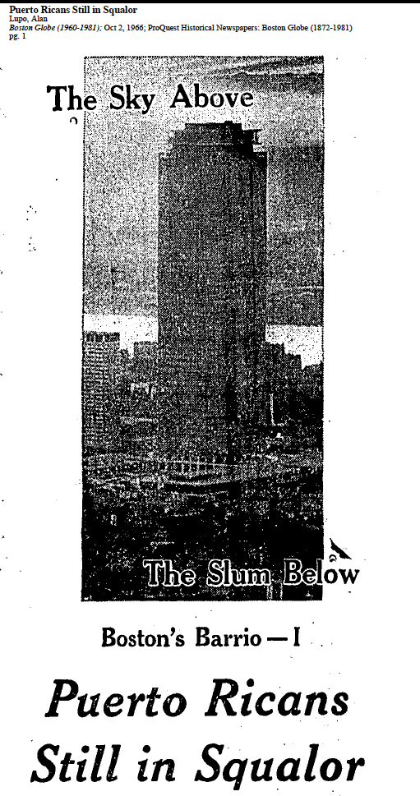
….of Migrants in the City

Slide 5
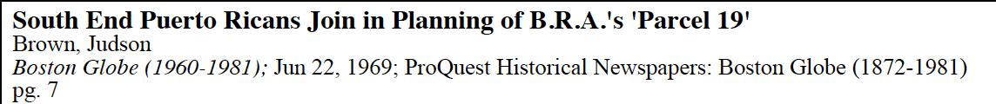
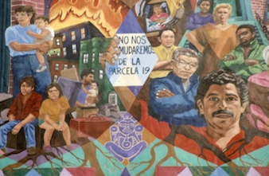
Villa Victoria

Slide 6
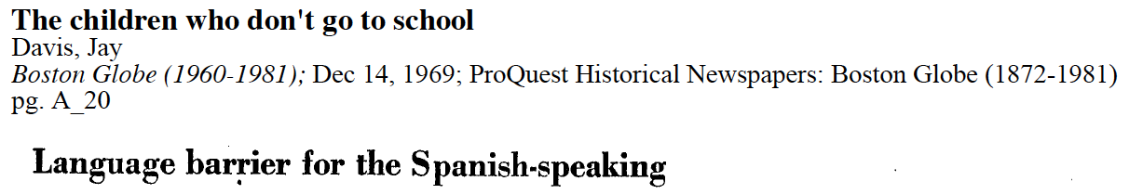
Children out of school

Slide 7
Children out of school
3d of Spanish speakers out of school
Taylor, F
Boston Globe (1960-1981); Nov 19, 1970; pg. 3

Slide 8
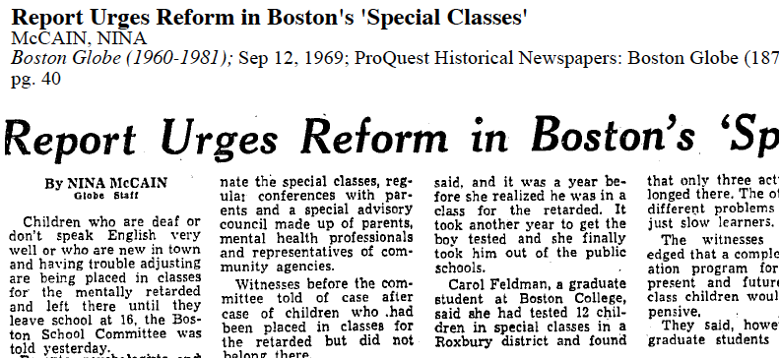
Conditions in the schools

Slide 9
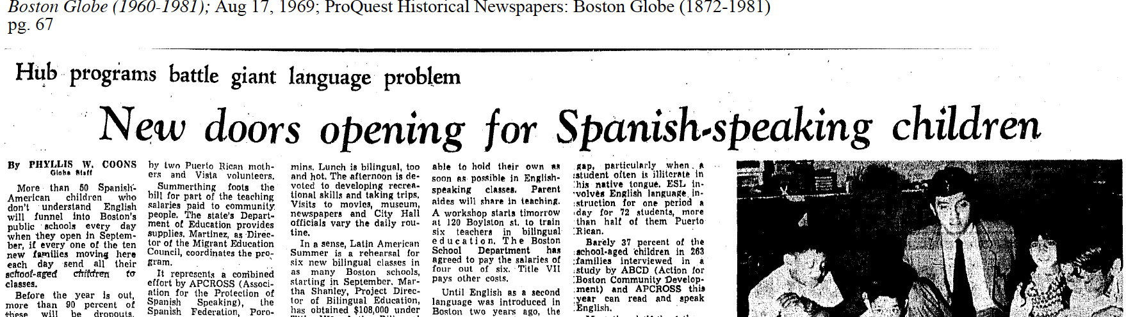
Latinos organize educational programs
Summer Programs

Slide 10
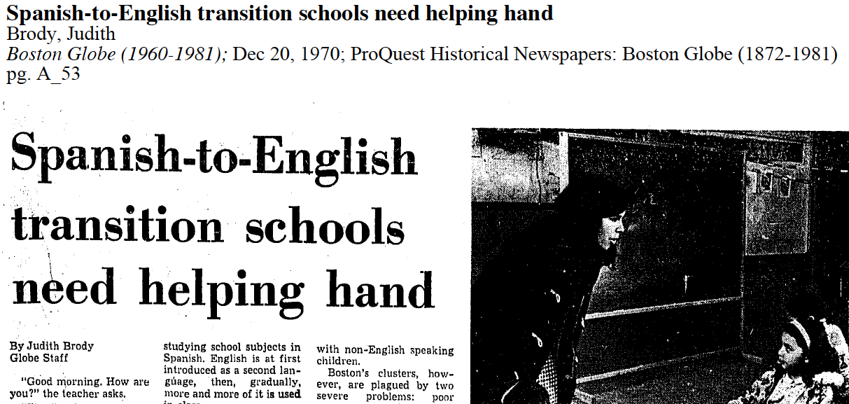
Bilingual Clusters

Slide 11
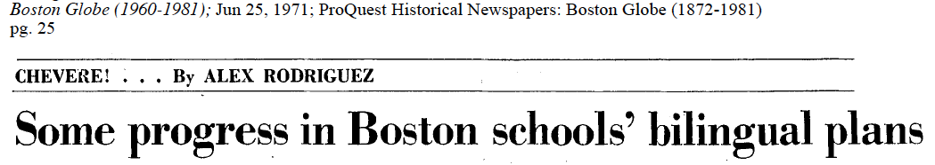

Slide 12
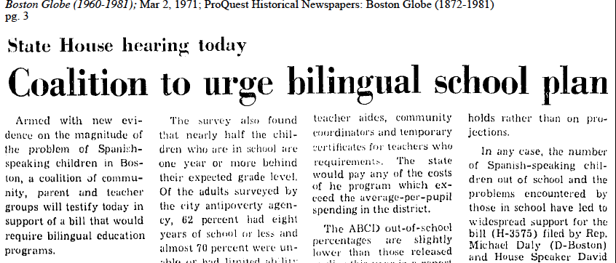
Transitional Bilingual Education Law

Slide 13
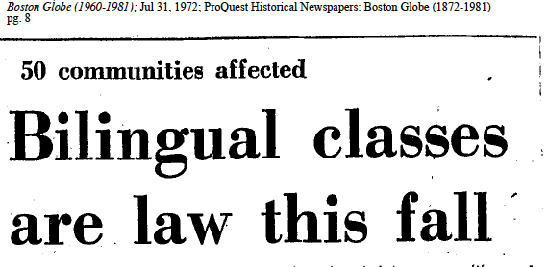
Transitional Bilingual Education Law

Slide 14
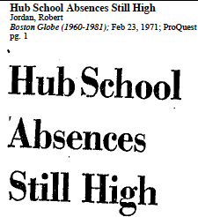
Desegregation…

Slide 15
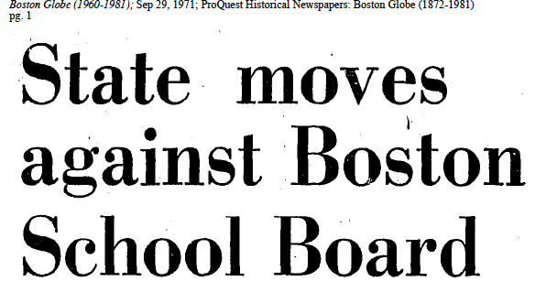
Desegregation…

Slide 16
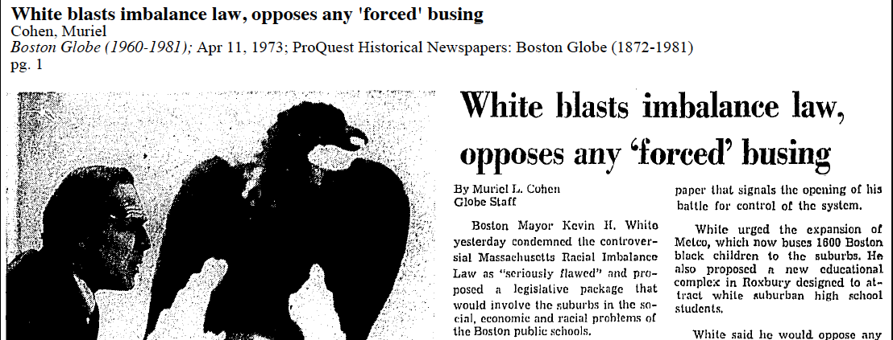
Desegregation…

Slide 17
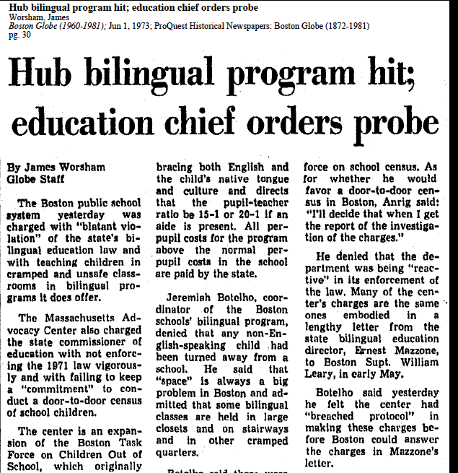
Problems Continued…

Slide 18
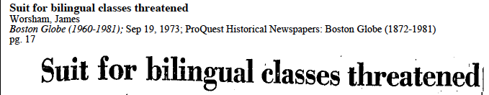
Problems Continued…

Slide 19
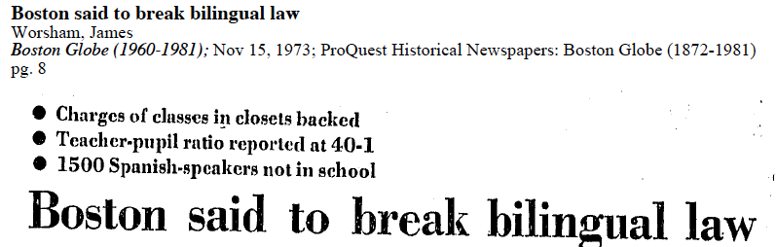
Problems Continued…

Slide 20
When Phase 2 starts…
Safety
Assignment
  Latinos were considered “other minority”
    used to racially balance heavily black or heavily white schools without a clear pattern
Bilingual Education Programs
  Clustering needed for bilingual programs

Slide 21
Comité de Padres en Defensa de la Educación Bilingüe
Plaintiff Intervener in the desegration case; continued in this role until the end of the court’s oversight in 1985
Vehicle for the inclusion of issues related to the rights of non-English speakers in the case
Focused on programmatic issues
“The Comité based its recommendations on educational, rather than racial grounds. It called assignments based on program need –bilingual education, in this case –as a first priority”. M Cohen, 7 parties file their ideas on school plan. The Boston Globe, Mar 4, 1975

Slide 22

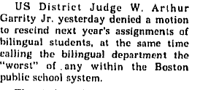
By 1977…
Notes:
In 1977
IN 2007….

